Slide 1
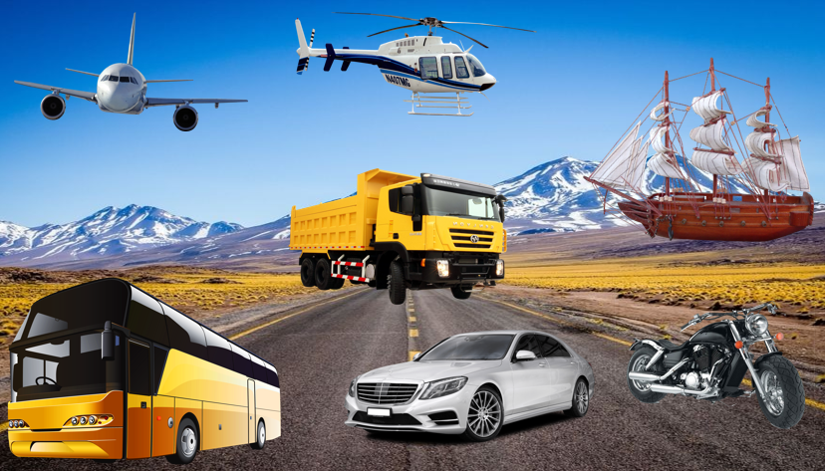

Slide 2
Answer the following questions about the previous image. / Contesta las siguientes preguntas sobre la imagen anterior.
How many yellow vehicles are there?
One of the following vehicles WAS NOT in the image:
balloon ship car plane
3. Which transport from the previous image goes on water?
4. Which two vehicles fly?

Slide 3
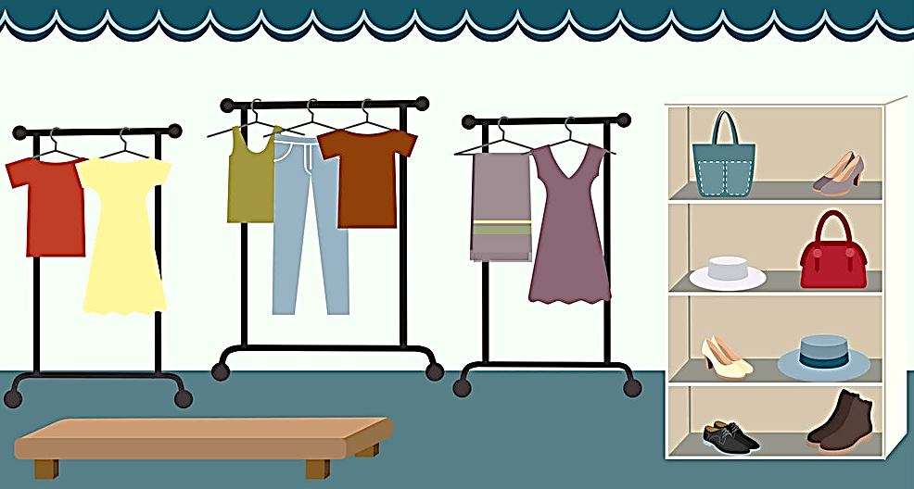
Three articles of clothing are incorrect- Write the correct ones in the notebook.
T-shirt
high-heels
socks
dress
hat

Slide 4
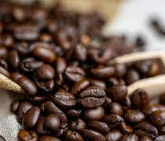
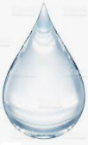
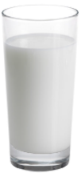
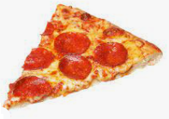
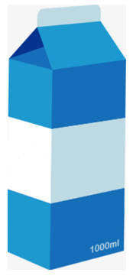

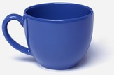
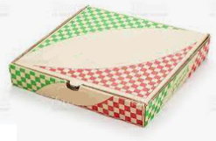
coffee
pizza
water
milk
Match the following food with their containers. / Une la comida con sus contenedores.
Write sentences with the containers and the products, for example: A carton of milk. / Escribe frases con los contenedores y los productos, por ejemplo: Una caja de leche.
cup
box
carton
bottle

Slide 5
Answer the following questions about yourself. (Yes, I do / No, I don’t) / Contesta las siguientes preguntas con tu información.
Do you like playing football?
Do you like jam?
Do you like roller-skating?
Do you like beans?
Do you like studying?

Slide 6
Match the following words with their places. / Une las siguientes palabras con sus lugares.
books
PLAYGROUND
SCHOOL
toys
students
magazines
HOUSE
screen
slide
CINEMA
food
swings
teacher
SUPERMARKET
BOOKSTORE
popcorn
family

