Slide 1
How many triangles are there?
How many circles are there?
How many arrows are there?
How many stars are there?
How many squares are there?
How many hearts are there?

Slide 2
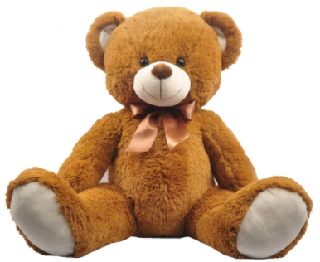



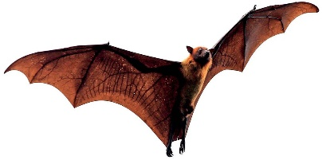
TOY STORE
SCHOOL
PLAYGROUND
vegetables
crocodile
swing
dolls
bus
students
toy car
monkey bars
fruits
shopping cart
SUPERMARKET
ZOO
BUS STOP

Slide 3
Complete the blanks in the answers. – Completar los espacios en blanco en las respuestas.
How do you say conejo? R _ B _ _ T
How do you say gato? _ _ T
How do you say maestro? _ E A _ H _ R
How do you say feliz? _ A P _ Y

Slide 4
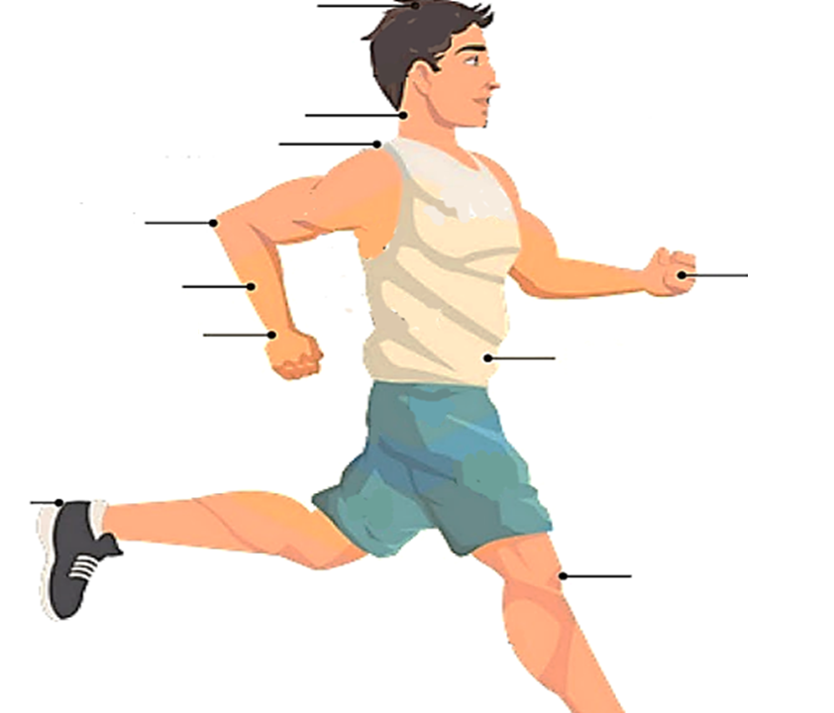
hair
Write the parts of the body that are missing.
Escribe las partes del cuerpo cuyos nombres faltan.
shoulder
hand
wrist
stomach

Slide 5
Write three fruits and three vegetables in the lines. Escribe tres frutas y tres verduras en las líneas.
_________________ __________________ __________________
_________________ __________________ __________________

